Slide 1


Token Economy
Vasiliki Spiliotopoulou
University of Pittsburgh

Slide 2

Outline
Introduction
What is a Token Economy system?
Key concepts
Research validation
Appropriate settings
Case Study 1
How to
Do’s
Don'ts
Case Study 2
FAQ
References

Slide 3

Introduction
Positive Behavior Support (PBS)
A constructive approach that focuses a) on the prevention, and b) on the management of classroom or school behavior problems.
The PBS approach operationalizes positive interventions to reduce negative behaviors, promote learning, and create safe educational environments.

Slide 4

Token Economy & PBS
A Token Economy is a behavior management system that works under the principles of PBS
  Universal intervention
  Research based
  Preventive implementation strategy

Slide 5

What is a Token Economy?
A Token Economy is a system that uses nonsocial reinforcers (tokens) to achieve positive behavior modification
As in real market, students earn or lose tokens when exhibit desired or undesired behaviors. The tokens have an actual market value and are used to purchase backup reinforcers

Slide 6

Level System
Variation of a token economy
Hierarchical or sequential levels
Increasing demands
Strengthen appropriate behaviors

Slide 7

Underlying principle
The underlying behavioral principle of a token economy is to:
gradually give a positive meaning to the token, which has a neutral value, by repeatedly pairing it with a positive reinforcer such as attention or praise

Slide 8

Glossary
Level system: A token economy system that has increasingly higher demands.
Reinforcer: A stimuli provided by the teacher immediately after the exhibition of a positive behavior to help increase or maintain that behavior.
Social reinforcer: Appraising behavior either from the teacher or from peers that is given immediately after a positive behavior occurs.
Token: Object earned after a behavior response and serves as a representation of points gained toward a reward.
Token economy: An economy system that uses tokens instead of money to achieve behavior modification. As in real market, students earn or loose tokens when exhibit desired or undesired behaviors. The tokens have an actual market value and are used to purchase backup reinforcers.

Slide 9
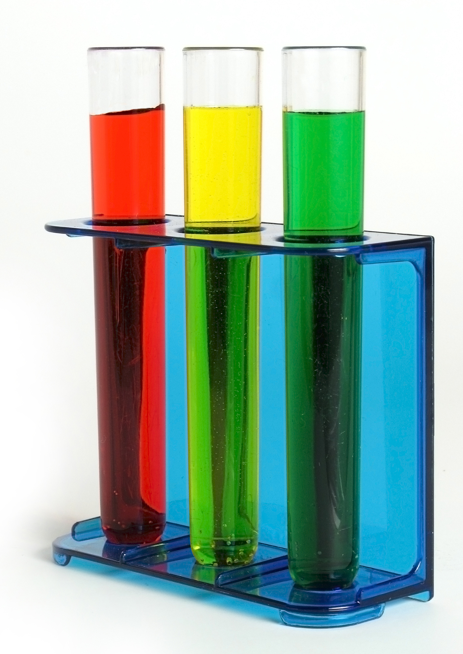
Brief summary of research
Efficacy has been established across settings
  Children diagnosed with ADHD (Hupp et al., 2002)
  Students with learning disabilities (Cavalier et al., 1997)
  Students with behavior problems (Filcheck et al., 2004)
  Children diagnosed with autism (Kazdin & Bootzin, 1972)
  Psychiatric patients (Kazdin & Bootzin, 1972)
  Token economies have been associated with increase in
  Social behaviors (Cavalier et al., 1997)
  Emotional behaviors (Kazdin & Bootzin, 1972)
  Academic achievement (Cavalier et al., 1997)
  Tokens:
  bridge the gap between the desired behavior and the reward (Hupp et al., 2002).

Slide 10

Where can I use a token economy system?
Regular or Special classrooms
Mild to severe disabilities
Preschoolers to adults
Individually or to a group
Classroom or wide school

Slide 11

Case Study
Ms. Petersen’s teaching career started in a rather rough manner. During her first teaching years, she was working in a low SES neighborhood school teaching a 6th grade class. Ms. Petersen was facing not only the challenge of her inexperience but the disruptive behavior of 4 of her students as well. Moreover, the rest of the students, were following the cues of their 4 classmates and were taking advantage of every opportunity to escape work.

Slide 12
Case Study
The 4 misbehaving students exhibited almost all kinds of unwanted classroom behaviors: being out of seat, talking out, failure to turn in assignments, and off task behaviors. It was clear to Ms. Petersen that she needed an intervention that would eliminate those behaviors and at the same time would promote the learning experience and the social skills of the whole classroom. But what?

Slide 13
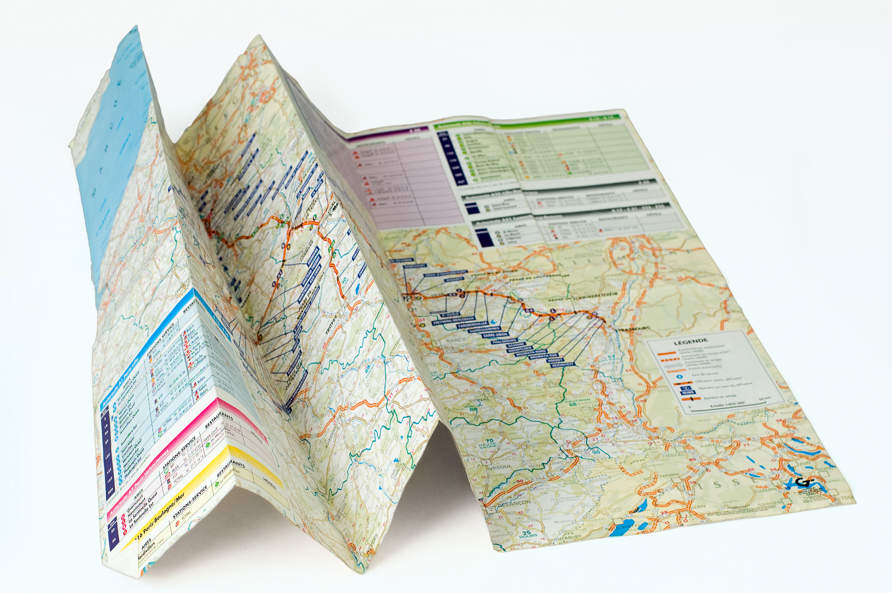
How to
Set aside at least two hours to plan your token economy
Decide which behavior/s are targeted
Be as specific as possible when describing the rules
Include your students when planning your project
Choose your reinforcers carefully
Monitor students’ progress regularly
Combine the gain of tokens with praise

Slide 14

Do’s
Label behaviors as “earners” and “losers”
Align the “earners” and “losers” with the student’s individualized IEP goals (if applicable)
Survey your students and find out what they like to do and what interests them
Explain the rules to the students in detail
Model first. Show your students how the system works
Create visuals about rules and fines
If you need help, find someone to help. However, train that person very well
Bonus points
Inform parents, guardians and supervisors
Be confident; you are using a very effective tool!

Slide 15
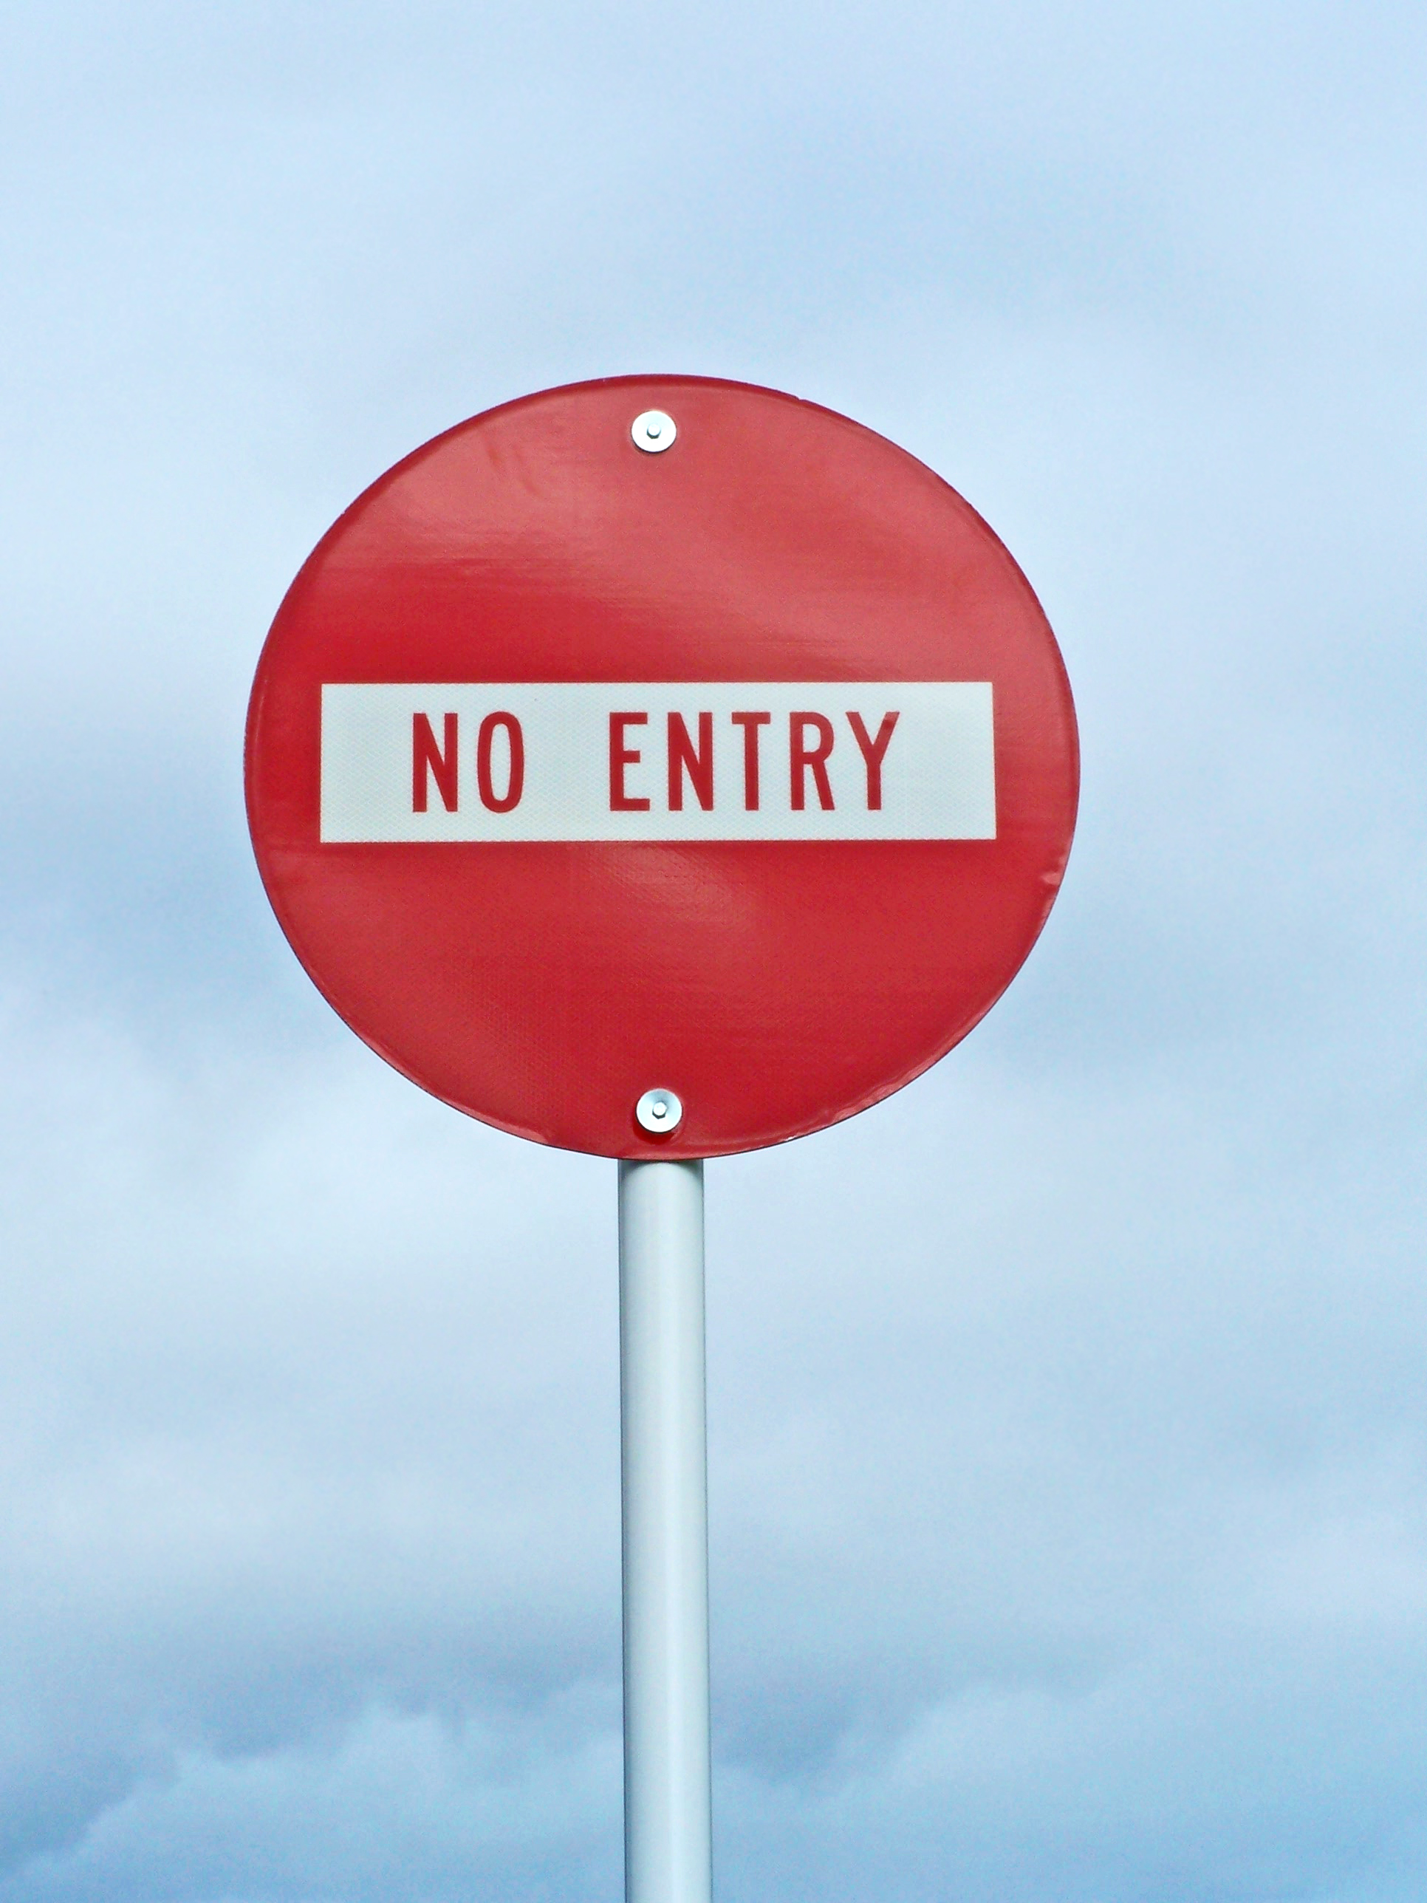
Don’ts
Choose tokens that students will be able to counterfeit or obtain somewhere else
Choose rewards that your students will obtain in any other way
Make complex rules
Let students end up without tokens
Allow token loans
Let difficulties discourage you
Neglect students’ legal rights

Slide 16

Case Study
You may recall the troubles that Ms. Petersen was facing as a young teacher. Four of her students had behavioral problems that held back their learning and were disrupting the function of the whole class.
In order to take care of the problem once and for all, Ms. Petersen decided to implement a token economy system. She remembered that once she had met a special education teacher that was implementing a token economy and she was raving about it!

Slide 17
Case Study
Ms. Petersen set up a company called the “Petersen Corporation”. All of her students were supposedly her employees that should fulfill their duties in order to receive their payment. Every time that a student earned a payment Ms. Petersen would give the student an amount of Pete-bucks. Pete-bucks were fake money that she designed and made. She photocopied a picture of her face and she put it in the center of the paper bill that she designed. In order to avoid counterfeiting she signed with a red marker every bill before laminating them.

Slide 18
Case Study
Next she made posters with the behaviors that she wanted to enforce. She devoted a lot of time in selecting them and describing them. She wanted to be as accurate and simple as possible so the students would know exactly what they were supposed to do.
As in any job setting, her students had to show up in class on time and to turn in their projects on time. Also, in the target behaviors she included “be in seat”, “raise your hand before talking”, “do not disrupt class” and “respect others”.
She also made another poster with the unwanted behaviors that cost students “Pete-bucks”. In that she included “be tardy”, “be out of seat”, “talk without permission” and “not complete assignments”.
Then she set up the “Pete Mart” in a corner of her class. Once a week the students could use their Pete-bucks to purchase products like stickers, fake tattoos, pens, pencils, little journals, hair pieces, miniature cars and bikes, etc. Students could also purchase vacations (free time), benefits (buying out an assignment), or privileges (be first in line).

Slide 19
Case study
Earners | Losers
Be in your seat when bell rings | Be tardy
Be in seat | Be out of seat
Turn in assignments on time | Talk without permission
Do not disrupt class | Not turn in assignments
Respect others | Break classroom rules

Slide 20
Case Study
As time went by and the behaviors that she targeted settled in, Ms. Petersen replaced them with more complex behaviors that needed more work.
Ms. Petersen always applied the basic principle of a token economy; she always praised her students for their behavior when she gave out the tokens.
Ms. Petersen’s token economy worked very well and she was proud to say that although she was a new teacher she managed very well!

Slide 21

FAQ
My students’ behavior is deteriorating instead of improving. What could it be wrong?
How can I keep my students motivated within the system?
What kind of tokens should I use?
What kind of reinforcers should I use?
How should I fade out my token system?
How can I evaluate the effectiveness of the system?

Slide 22

References
Cavalier, A. R., Ferretti, .R. P., Hodges, A. E. (1997). Self-management within a classroom token economy for students with learning disabilities. Research in Developmental Disabilities, 18(3), 167-178.
Filcheck, H. A., McNeil, C. B., Greco, L. A., Bernard, R. S. (2004). Using a whole class token economy and coaching of teacher skills in a preschool classroom to manage disruptive behavior. Psychology in the Schools, 41(3), 351-361.
Hupp, S. D. A., Reitman, D., Northup, J., O’Callaghan, P. M., LeBlanc Monique (2002). The effects of delayed rewards, tokens, and stimulant medication on sportsmanlike behavior with ADHD-diagnosed children. Behavior Modification, 26(2), 148-162.
Kazdin, A. E. & Bootzin R. R. (1972). The token economy: an evaluative review. Journal of Applied Behavior Analysis, 5, 343–372.
Kerr, M. M. & Nelson, C. M. (2006). Strategies for addressing behavior problems in the classroom, 5th Edition. Columbus, Ohio: Charles E. Merrill Publishing Company.
Reitman, D., Murphy, M. A., Hupp, S. D. A., O’Callaghan, P. M. (2004). Behavior change and perceptions of change: evaluating the effectiveness of a token economy. Child and Family Behavior Therapy, 26(2), 17-36.
All the photographs were retrieved form http://www.sxc.hu/home on March 31, 2009.

